Slide 1
Master Data Management
Frank Olav Estensen
Business Consultant
Affecto AS
© Affecto 2008

Slide 2
Master data – what is it?
Master data is data shared across computer systems in the enterprise.
Master data is the dimension or hierarchy data in data warehouses and transactional systems
Master data is core business objects shared by applications across an enterprise
Slowly changing Reference data shared across systems
Master data is data worth managing
© Affecto 2008

Slide 3
Master data vs. Metadata vs. Transactional
Transactional
Company | Country | Account | Sub-Account | Date | Amount
Affecto | NO | 505050 | 500 | 20080301 | KR30.000
Metadata
Company | Country | Account | Sub-Account | Date | Amount
Text | Text | Integer | Integer | Date | Float
nVarchar(50) | Char(2) | Int(6) | Int(3) | Datetime (YYYYMMDD) | Decimal
Master data
Products
Customers
Country
Software
Affecto OY
Europe
Hardware
Affecto AS
Norway
CPU
Affecto AB
Sweden
© Affecto 2008

Slide 4
Master data applications
Product master data
  Product Information Management (PIM)
Customer master data
  Customer Data Integration (CDI)
Analytical master data
  Hierarchies used for reporting
Other possible
  Recipe master data
  Vendor master data
  Employee master data
© Affecto 2008

Slide 5
MDM – implementation styles
MDM is Master data Hub or System of Record (SOR)
MDM is System of Entry (SOE)
MDM
Source systems
Subscribing systems
MDM
Subscribing systems
© Affecto 2008

Slide 6
What is Master Data Management
  The processes and technology to produce and maintain a single clean copy of master data
  The “Golden” record
An Application for creating and maintaining an authoritative view of master data including policies and procedures for access, update, modification, viewing between systems across the enterprise
© Affecto 2008

Slide 7
Why master data management?
Different people involved
Inevitable manual process
Error-prone, inconsistent
No way to audit
No way to rollback changes
Time and resource consuming
Updates are “interpreted” by systems experts
PPS
Essbase
Essbase
Analysis Services
PPS
Admin
DW
Accounts
Entity
Project
Product
Location
Channel
ETL
EAI
ERP
Admin
Spreadsheet
Dynamics
ERP
SAP
Custom
Review
Spreadsheet
Business
User
IT Admin
E-Mail
© Affecto 2008

Slide 8
Master data Management solution
Single version of truth
Master data synchronized and validated
Data maintained by Business Users and domain experts – not systems experts
PPS
Essbase
Essbase
Analysis
Services
DW
Accounts
Entity
Project
Product
Location
Channel
ETL
EAI
MDM
Dynamics
ERP
SAP
Custom
Business
User
© Affecto 2008

Slide 9
Governance & Compliance
Master data governance
  Can you track changes in dimensions?
  Do you know who made the changes?
  Do you know when changes occurred?
  Can you produce a dimension from Q2 last year?
Compliance
  International accounting standard
  Transparency and auditability
© Affecto 2008

Slide 10
Main parts of a Master data management system
Import of master data records
Cleansing and enhancement interface
Workflow for approval
Verifications and validations
Versioning and life-cycle management
Logging for compliance, governance and auditing
Export of master data records
© Affecto 2008

Slide 11
Microsoft MDM Philosophy
Multi-domain hub
Open interfaces
Incremental implementation
Distributed, Federated MDM
Partner for domain specific solutions
Use existing integration capabilities
Tight integration with Microsoft Products
Hierarchy Management a critical capability
Data Stewardship - key success factor
Analytical and Operational MDM just two uses for the same data
© Affecto 2008

Slide 12
Microsoft enters the MDM market - Roadmap
Acquires Strataure and the +EDM product in June 2007
Technology Preview of Microsoft +EDM released November 2007
CTPs at major milestones
Microsoft MDM v1 ships with Office 14
© Affecto 2008

Slide 13
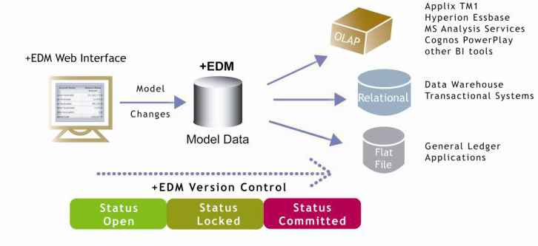
+EDM basic architechture
© Affecto 2008

Slide 14
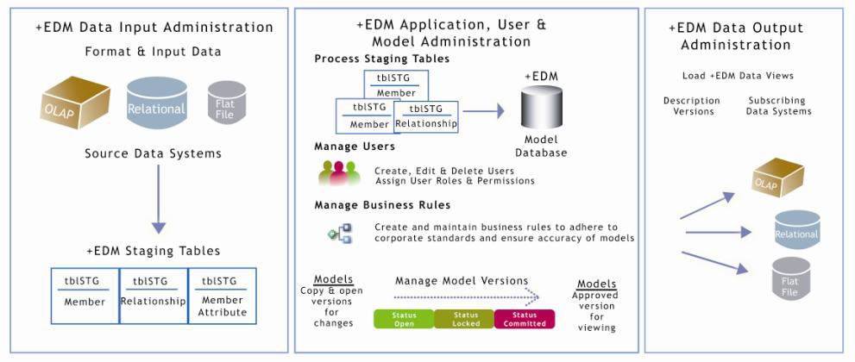
EDM dataflow
© Affecto 2008

Slide 15
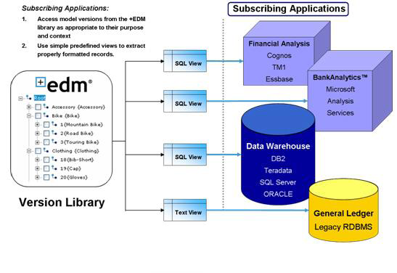
Microsoft MDM – Integration - Export
© Affecto 2008

Slide 16
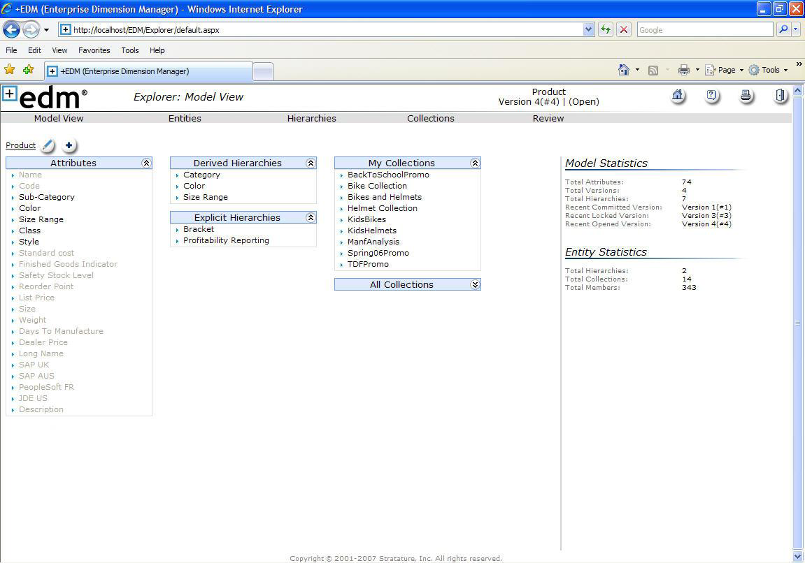
+EDM User interface
© Affecto 2008

Slide 17
Microsoft MDM terminology
Model
Version
Member
  Leaf-Level
  Consolidated
Hierarchies
  Derived
  Defined
Attributes
  Free-Form
  Domain Based
  File
Business Rules
  Validations
  Setting attribute values (Derived attributes)
© Affecto 2008

Slide 18
+EDM Main features
Multi-model solution
Versioning and life-cycle management
Fine grained security model
Web based UI
Business rules for validations and attribute defaults
Derived and defined hierarchies
Collections for non-hierarchical member views
© Affecto 2008

Slide 19

From +EDM to Microsoft MDM
Integrate with SharePoint for UI, human workflow, user management and portal capabilities
Integrate with BizTalk for near real-time integration and orchestration
Improve data load with capabilities from SQL Server and SSIS
More direct support for Microsoft MDM in other Office products
© Affecto 2008

Slide 20
Demo
© Affecto 2008

Slide 21
Resources
Microsoft’s MDM Web site:
  http://www.microsoft.com/mdm
MSDN Forum:
  http://forums.microsoft.com/MSDN/default.aspx?ForumGroupID=519&SiteID=1
Blogs
  http://sqlblog.com/blogs/knightreign/default.aspx
  http://blogs.msdn.com/rogerwolterblog/default.aspx
© Affecto 2008

